Slide 1
DCJS
Grant Writing
Overview
SRO/SSO
Grant Applications

Slide 2
DCJS Grant Monitor
Patrick Harris
(804) 786-5367
patrick.harris@dcjs.virginia.gov

Slide 3
Grant Writing Overview
Why are you requesting a grant?
Grant writing tips
Grant Application and Itemized Budget
Needs Statement, Project Description and Budget Narrative
Goals, Objectives and Timelines
Completed Grant Application Package
Grant Award

Slide 4
Source of SRO/SSO Grant Funding
School Resource Officer and School Security Officer Grant Program is supported by state funds included in the annual state budget.
Typically about $1,000,000 per year is authorized.
The grant funds staffing of SRO & SSO positions in local schools.

Slide 5
Why are you applying
for a grant?

Slide 6
Questions
What is the purpose of your grant?
What is the problem?
Why does it exist?
Who is impacted by it?

Slide 7
Questions
How will this grant meet your need?
What are the details of your plan?
Why is this plan appropriate?
How will you evaluate and report on your grant activities?

Slide 8
Grant Writing Tips
Give the grant reviewer the information needed to review your grant:
Provide the details that clarify and support your grant plans.
Provide good reasons for funding the purpose and goals of your project.
Ensure that the proposal is well written.

Slide 9
Grant Writing Tips
Keep the grant reviewer happy, don’t submit an application that is difficult to review and rate.
Follow the instructions and only submit items that are requested and as they are requested.
Don’t assume the grant reviewer knows all of the trending topics. If in doubt, explain.

Slide 10
Grant Writing Tips
Be concise, use clear specific language.
Avoid complicated sentences.
Avoid very technical or overly dramatic language.
Don’t use unexplained acronyms.
Use correct spelling, grammar and punctuation.

Slide 11
Grant Writing Tips
What if your grant is approved and you are not involved in implementing it?
Is the grant written in a manner that will enable another person to take over the grant and implement it?
Be cautious about you being the only person who prepares grant applications. What happens if you leave?

Slide 12
Know Your Local Process for
Accepting Grants
Understand the process in your locality for accepting grants. Quite often this process may take up to one month.
The grant may require an in-kind or cash match that must be supported by your locality.

Slide 13
SRO-SSO Grants

Slide 14
Recent Changes - SRO/SSO Grants
Total grant budget for salary and fringe benefits has been increased to $70,000 for a SRO and $35,000 for a SSO.
In-kind match based on the Ability to Pay Index is allowed.

Slide 15
Fundable Costs
Salary and fringe benefits only.
Full-time or part-time SRO or SSO positions.
Provide coverage during routine school hours or after school activities.

Slide 16
Fundable Costs
Grant funds may not be used for equipment, training, travel or other services or other activities
Grant period one year.
Once a grant is awarded it may be continued for up to three years, provided that state funding is available.

Slide 17
SRO/SSO Grants In-Kind Match
Total budget for a SRO position is $70,000 and $35,000 for a SSO position.
This total is a combination of the DCJS funds you are requesting and your in-kind match based on your Ability to Pay Index.
Your in-kind match is subtracted from the grant limit and the remainder is the grant that will be awarded.

Slide 18
SRO/SSO Grants In-Kind Match
If your Ability to Pay Index is .300, your in-kind match for a fully funded $70,000 SRO would be $21,000.
Subtracting the in-kind match results in $49,000 that will be awarded by DCJS for
SRO salary and fringe benefits.
If your salary and fringe benefits exceed $49,000 you would be responsible for those costs, which can be used for match.

Slide 19
In-Kind Match SRO/SSO Grants
In-kind Match is a good or service that can be given a value and is used in achieving your program objectives.
In-kind Match may be in the form of real property, equipment, supplies, services and other expendable property.
Examples include: labor, office space, vehicles, training, equipment, services.

Slide 20
SRO/SSO
Grant Application

Slide 21
Components of the Application
Grant Application Form – Face Sheet
Itemized Line Item Budget Form
Budget Narrative
Needs Assessment
Project Description
Goals and Objectives Form
Performance Measures and Timeline

Slide 22
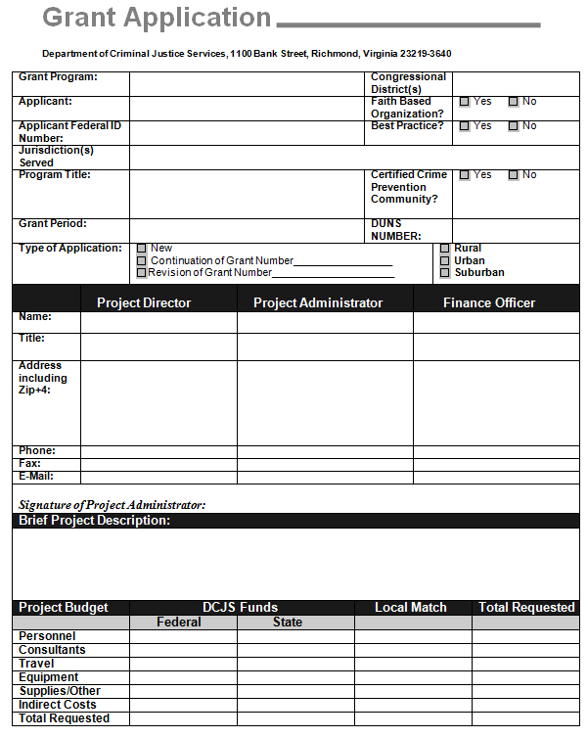
DCJS Grant Application Form

Slide 23
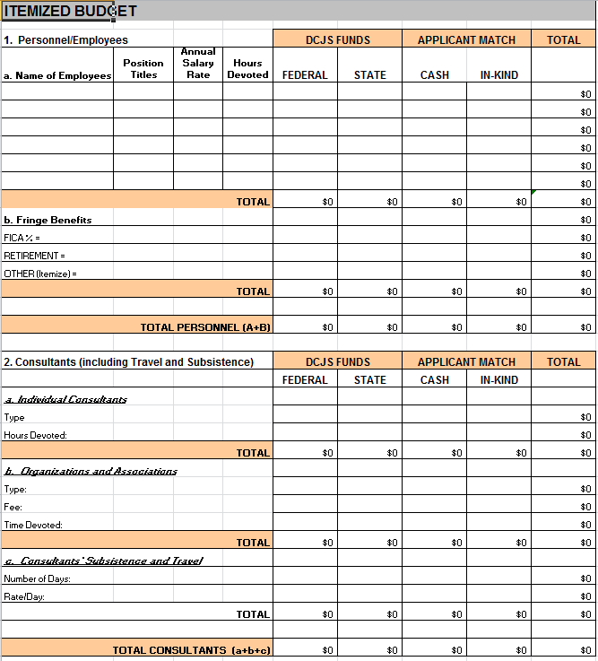
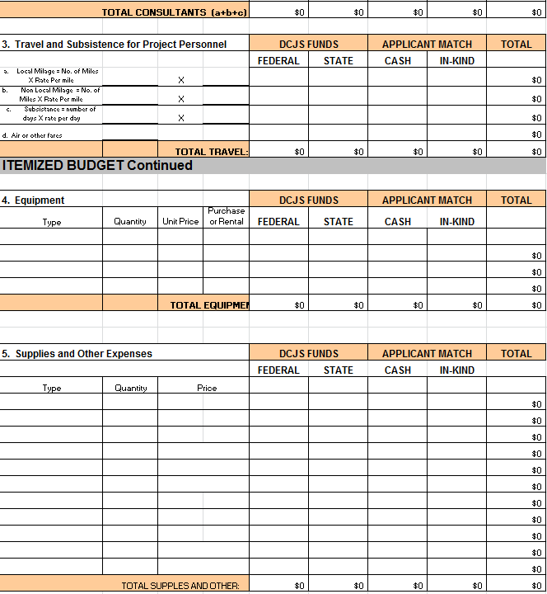
Itemized Budget Form

Slide 24
Grant Budget
Matching Funds May Be Required
Matching funds included are subject to the same requirements and conditions which apply to the federal or state funds awarded by DCJS.
These include the certifications and assurances required to be submitted with the grant application and any conditions attached to the grant award.

Slide 25
Budget Narrative
The Budget Narrative explains the reason for the requested budget items and provides the basis for their cost.
Items requested must be justified and related to the proposed project.
Each type of item must be listed with its unit cost. Explain the relevance and importance of each item to the project.

Slide 26
Needs Statement
Description of your agency and community.
Description of the unmet need or problem that the your grant project will address.
Fully describe how the project will reach the stated goals of the project to address your needs.

Slide 27
Project Description
Explain how your proposal will address the identified need and how it will impact the problem you propose to address.
Provide details of how the project will operate throughout the funding period.
Describe the activities that will be implemented to achieve the goals and objectives of your project.

Slide 28
Allowable Expenses
Prohibited Expenses
Only salaries and fringe benefits can be funded with the SRO/SSO grant program.
Equipment, travel, training and other costs are not fundable.

Slide 29
Supplanting
Existing funds for a project and its activities may not be displaced by state or federal funds and reallocated for other organizational expenses.
Example - using state or Federal grant funds to pay the salary of an existing locally funded SRO/SSO position.

Slide 30
Project Goal
Goal: an overarching principle that guides decision making.
There should be just one Goal.
“The police department and public school system will continue their partnership to promote school safety and reduce juvenile violence through the assignment of a new School Resource Officer at XYZ High School.”

Slide 31
Project Objectives
Objective: specific steps that can be taken
to meet the Goal.
Objectives should address safety, security and juvenile delinquency issues identified in the Project Narrative. Number each objective.

Slide 32
Project Objectives
Each objective must be:
Specific,
Measurable,
Achievable,
Related to the project goal, and
Time-bound or SMART.
Submit a separate form for each objective.

Slide 33
Project Activities
Activity: measureable, time based specific actions or tasks you undertake to achieve your objectives in support of your goal.
Activities are tasks that will be undertaken each quarter to accomplish each objective and to complete the project successfully.

Slide 34
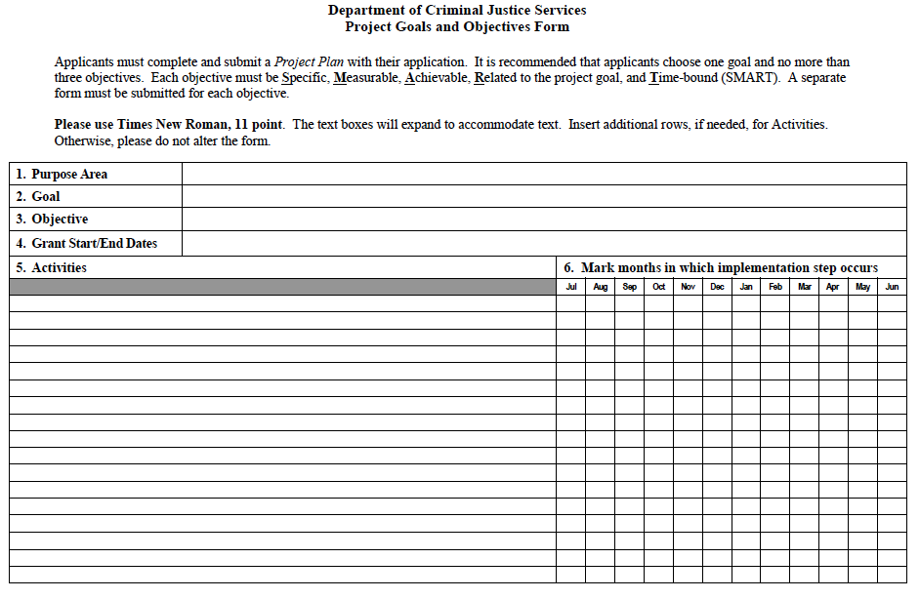
Goals and Objectives Form

Slide 35
SRO Example
Goal
Objective
Activities

Slide 36
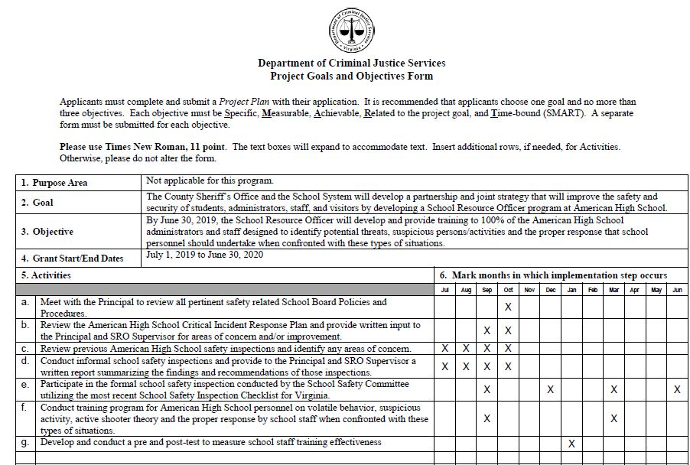

Slide 37
SRO Goal Example
The County Sheriff’s Office and the School System will develop a partnership and joint strategy that will improve the safety and security of students, administrators, staff, and visitors by developing a School Resource Officer program at American High School.

Slide 38
SRO Objective Example
By June 30, 2019, the School Resource Officer will develop and provide training to 100% of the American High School administrators and staff designed to identify potential threats, suspicious persons/activities and the proper response that school personnel should undertake when confronted with these types of situations.

Slide 39
SRO Activities Examples
Successfully complete a DCJS sponsored SRO training/certification course.
Meet with the Principal to review all pertinent safety related School Board Policies and Procedures.

Slide 40
SRO Activities Examples
Review the American High School Critical Incident Response Plan and provide written input to the Principal and SRO Supervisor for areas of concern and/or improvement.
Review previous American High School safety inspections and identify any areas of concern.

Slide 41
SRO Activities Examples
Conduct informal school safety inspections and provide to the Principal and SRO Supervisor a written report summarizing the findings and recommendations of those inspections.
Participate in the formal school safety inspection conducted by the School Safety Committee utilizing the most recent School Safety Inspection Checklist for Virginia.

Slide 42
SRO Activities Examples
Conduct training program for American High School personnel on volatile behavior, suspicious activity, active shooter theory and the proper response by school staff when confronted with these types of situations.
Develop and conduct a pre and post-test to measure school staff training effectiveness.

Slide 43
Performance Measures Examples
How many and what types of training sessions were conducted for school staff?
How many staff participated?
How many and what law related education courses were provided for students?
How many students participated?

Slide 44
Performance Measures Examples
How many school safety assessments were conducted?
How many weapons were seized?
How many students were referred for counseling?

Slide 45
Completed Grant
Application Package

Slide 46
Application Items to Submit
  Grant Application Forms and Descriptions
  Signed Application Form/Facesheet
  Itemized Budget and Budget Narrative
  Needs Assessment
  Project Description
  Goals and Objectives Form

Slide 47
SRO Grant Requirements
2018–2020 Composite Index of Local Ability-to-Pay used to calculate In-Kind Match
School where the position will be placed.
SRO Memorandum of Understanding
SRO Departmental General Order
SRO Training Certification Form
SRO Sustainment Plan

Slide 48
SSO Grant Requirements
2018–2020 Composite Index of Local Ability-to-Pay used to calculate In-Kind Match
SSO Training Certification Form
SSO Sustainment Plan

Slide 49
Submit Application as One PDF File
Make sure to combine the various components of the grant into one PDF document.
Do not submit multiple separate documents or files.
Do not include any unrequested attachments.

Slide 50
Submit the Application
Applications must be submitted using the format and forms identified in the guidelines. Do not alter the forms.
The Application must have an email time stamp of no later than the date specified in the grant solicitation notice.
Applications received after the application deadline or submitted by mail or FAX will not be considered.

Slide 51
Submit the Application
Applications must be emailed to:
grantsmgmt@dcjs.virginia.gov

Slide 52
Grant Review and Awards

Slide 53
Application Review Process
DCJS staff will review grant applications and forward recommendations to the Grants Committee of the Criminal Justice Services Board (CJSB) which will, in turn, make recommendations to the full CJSB.
Final approval is by the Criminal Justice Services Board.

Slide 54
Rating Grants
A standardized form is used to review and rate grant applications. At least two DCJS staff review each application.
An application can earn a maximum score of 65 points.
The grant program elements are evaluated based on staff ratings of Excellent, Acceptable, Marginal, or Unacceptable.

Slide 55
Rating System
Discretionary grants, such as the SRO/SSO grants, are competitive grants and typically the demand is greater than the available funds.
The rating system is used to select the highest rated grants for funding.

Slide 56
Grant Rating
Itemized Budget 0-6 points
Budget Narrative 0-9 points
Needs Justification 0-12 points
Project Description 0-12 points
Goals and Objectives 0-9 points
Implementation Steps 0-9 points
Technical Compliance 0-3 points

Slide 57
Bonus Points
Applications from communities where the law enforcement agency is accredited by the Virginia Law Enforcement Accreditation Program receive three (3) bonus points.
Applications from Certified Crime Prevention Communities receive two (2) bonus points.
If applicable, an applicant can claim up to five (5) bonus points.

Slide 58
Reason for Denial - Weak Application
Discretionary grants are competitive and poorly written grants will have lower ratings.
Weak or insufficient Needs Statement or Project Description or Budget Narrative.
Insufficient description of measureable, time based grant activities – SMART.

Slide 59
Reason for Denial - Application Errors
Grants may be denied for technical reasons.
Incorrect Project Administrator.
Grant face sheet not signed.
Forms signed by the wrong official.
Required grant components not included: Needs Statement, Project Description, Budget Narrative, or requested forms.

Slide 60
Accepting the Award
Organizations approved for a grant award will receive a Grant Awards Package.
The awards package includes instructions for implementing and managing the grant.
A Statement of Grant Award/Acceptance form must be signed by the grant Program Administrator and returned to DCJS within 60 days of the grant start date.

Slide 61
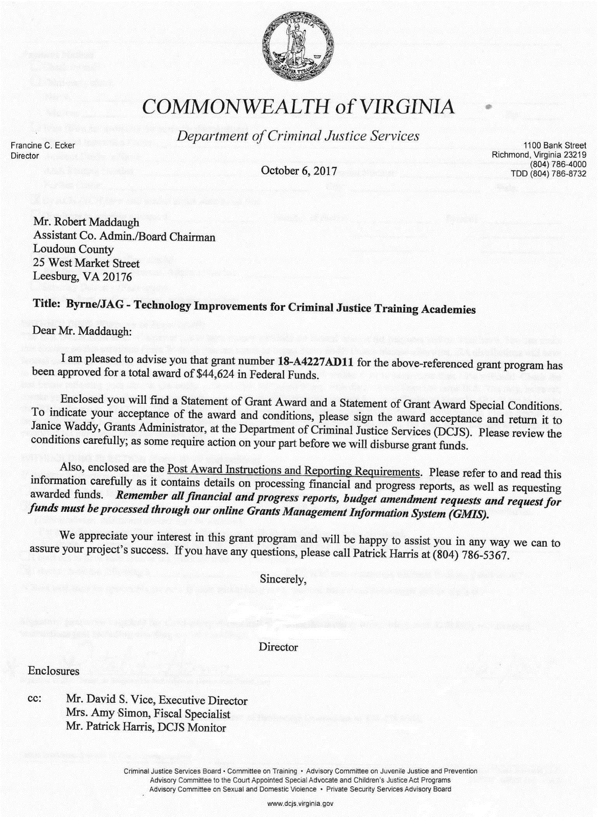
Statement of Grant Award – SOGA
Award Letter

Slide 62
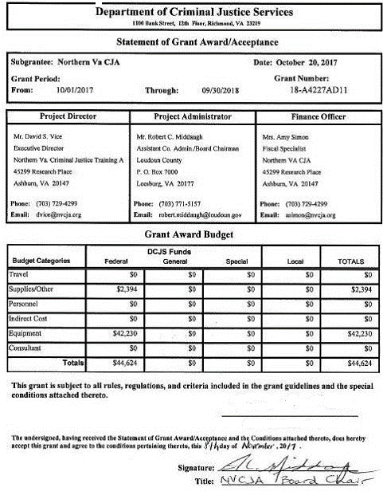
Statement of Grant Award – SOGA
Acceptance
This form must be signed by the Project Administrator and returned to DCJS.

Slide 63
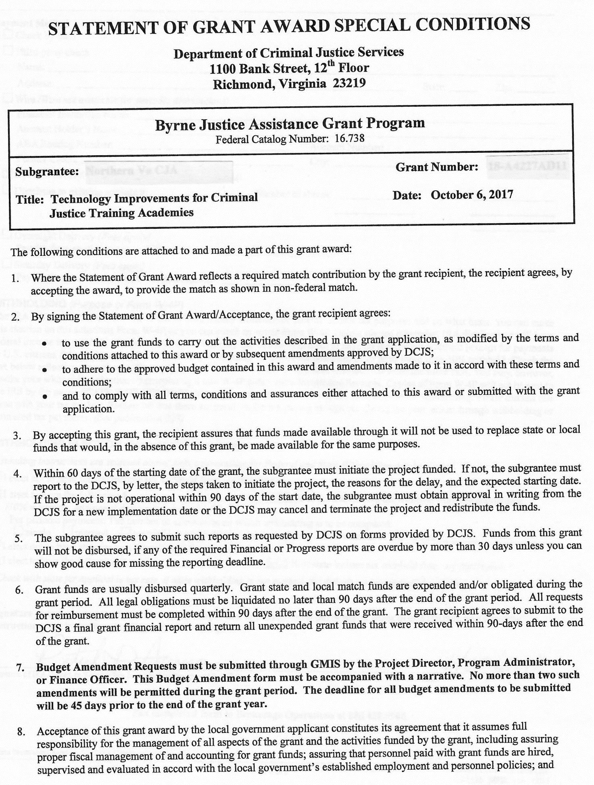
Grant Award Conditions

Slide 64
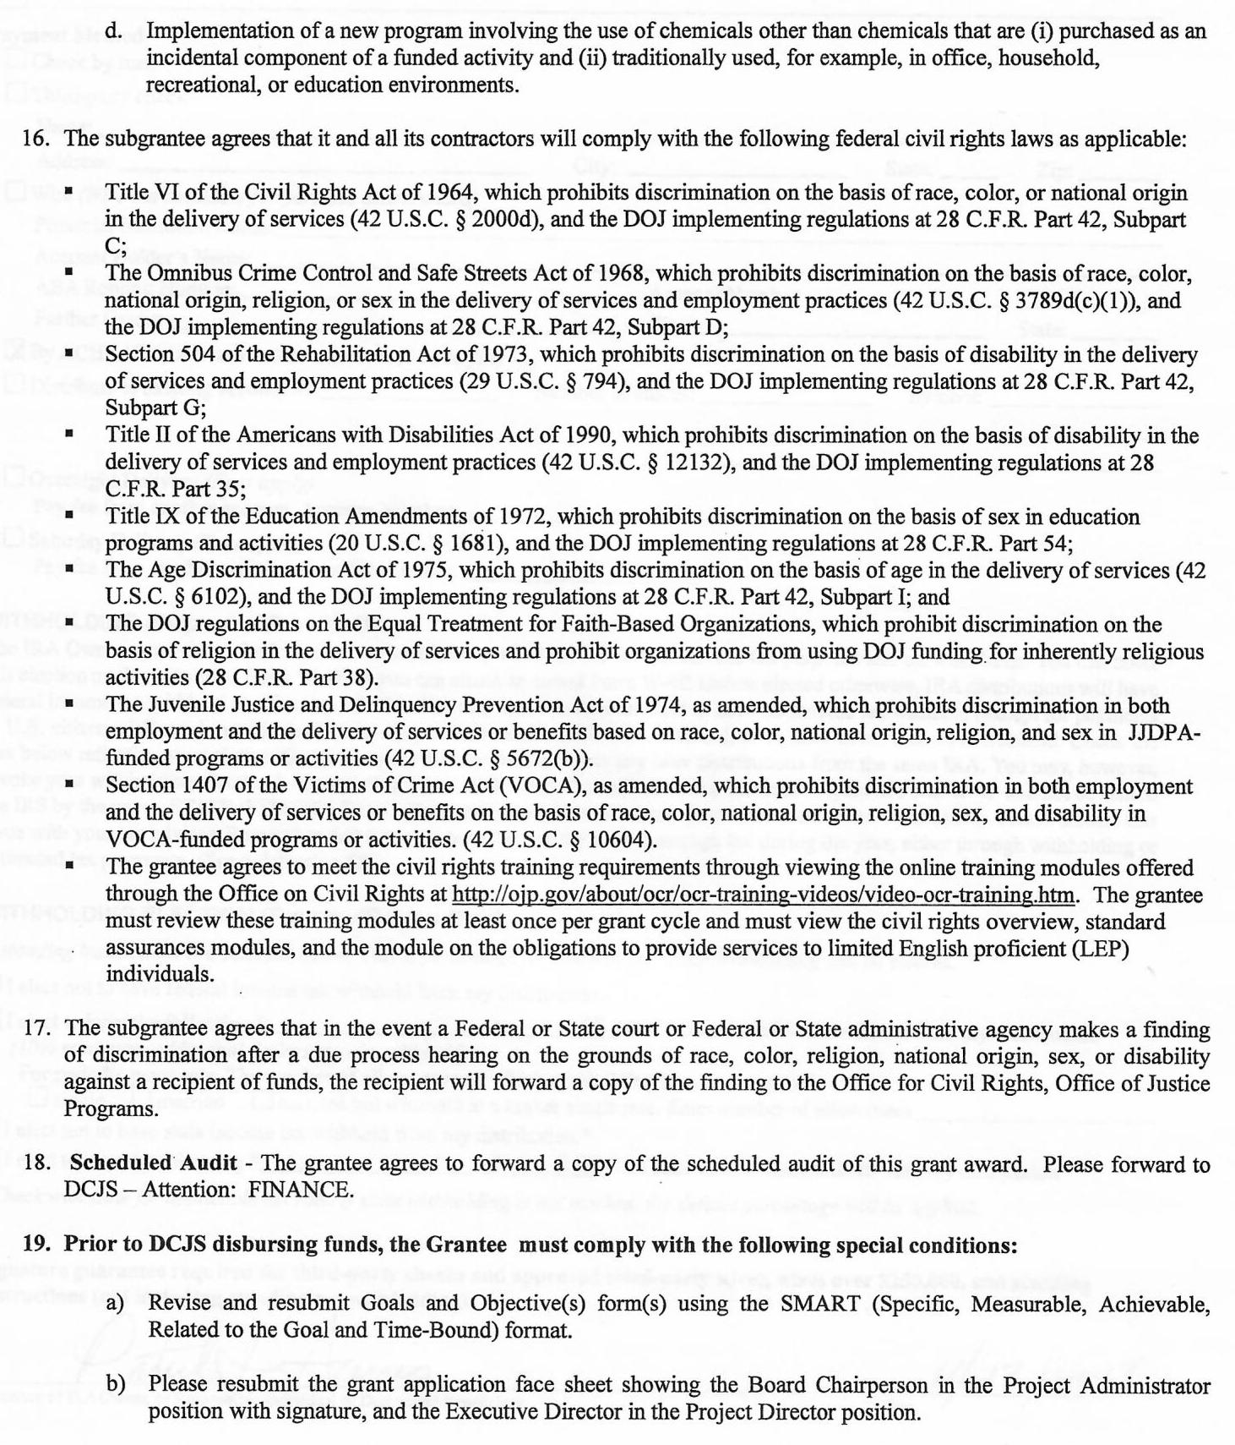
Special Conditions
# 19
A well written grant should not have any Special Conditions.

Slide 65
Special Conditions
Special Conditions may be placed on your grant because of deficiencies in your grant application.
These Special Conditions must be met before you can access grant funds.

Slide 66
Typical Special Conditions
Resubmit the grant application face sheet showing the County Administrator in the Project Administrator position with signature, and the County Finance Officer in the Finance Officer position.
Revise and resubmit Goals and Objectives forms using the SMART format: Specific, Measurable, Achievable, Related to the Goal, and Time-Bound.

Slide 67
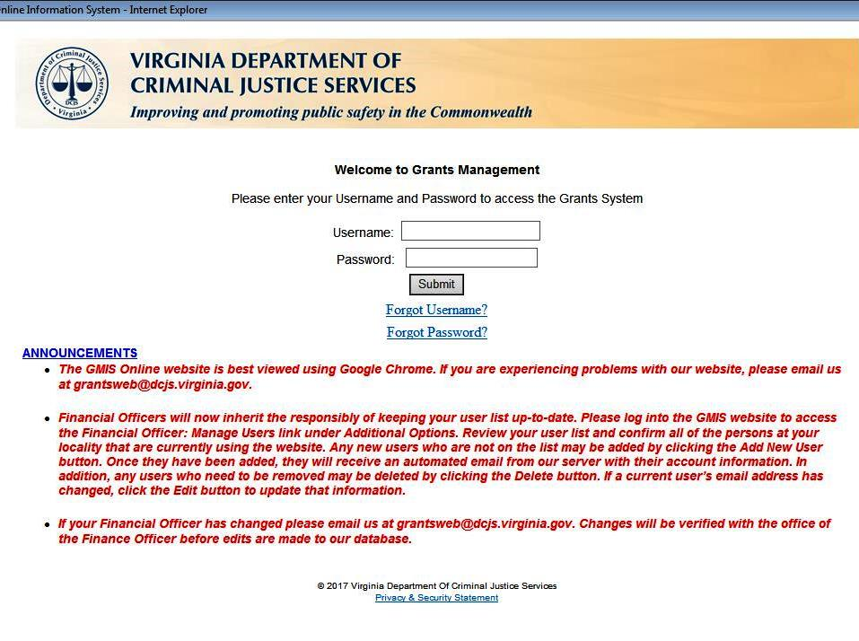
DCJS Grants Management System
Online Grant Reporting

Slide 68
Submitting Quarterly Reports
Progress and Financial Reports must be submitted at the end of every quarter online through the DCJS Grants Management Information System or GMIS.
These reports must be submitted even if there was no grant activity or if no funds were expended.

Slide 69
Quarterly Reporting
Reports are due by the 12th working day following the close of the quarter covered by the report.
  Quarter Ending Due Date
  12/31/2018 01/17/2019
  03/31/2019 04/17/2019
  06/30/2019 07/18/2019 09/30/2019 10/17/2019
  12/31/2019 01/17/2020

Slide 70
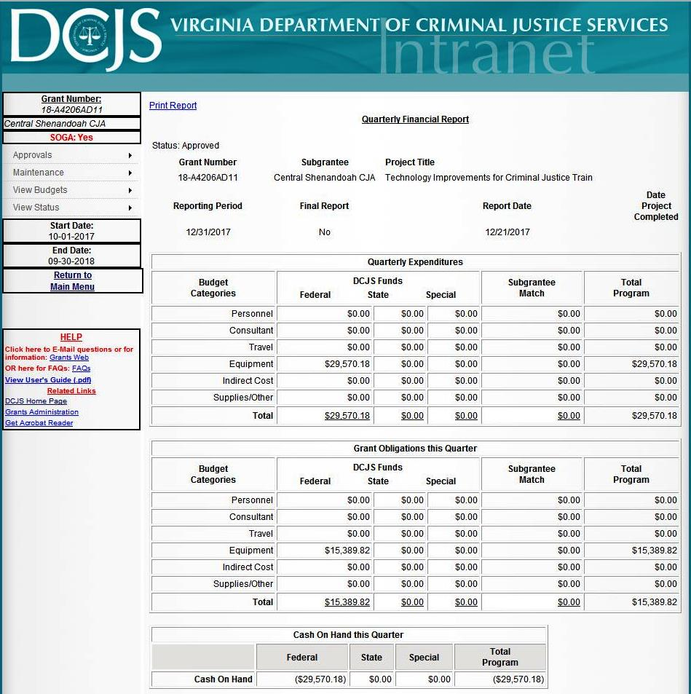
Quarterly Financial Report Screen Shot

Slide 71
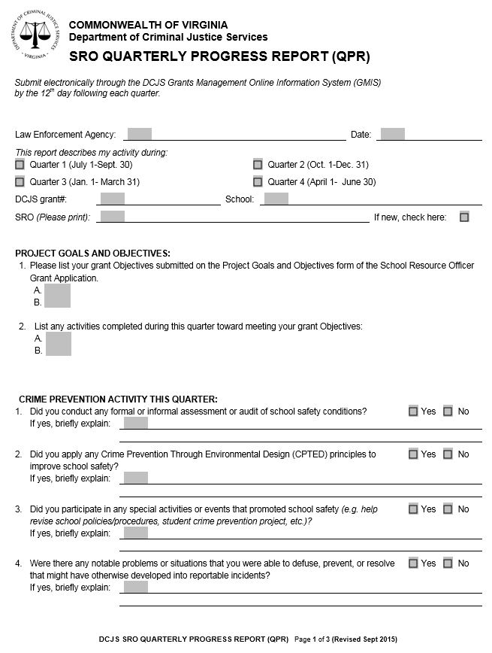
Quarterly Progress Report Form page 1 of 3

Slide 72
DCJS Grant Monitor
Patrick Harris
(804) 786-5367
patrick.harris@dcjs.virginia.gov

